Slide 1


A Deterministic Memory Allocator for Dynamic Symbolic Execution
Daniel Schemmel, Julian Büning, Frank Busse, Martin Nowack, Cristian Cadar

Slide 2
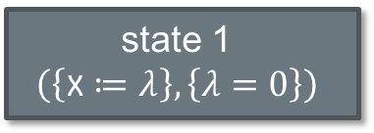
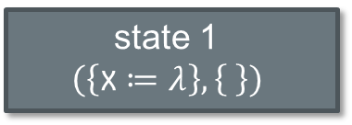
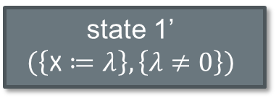
Dynamic Symbolic Execution
state 1
$$\left(\left\{\text{x}≔λ\right\},\left\{ \right\}\right)$$
int x = input();
if (x == 0) {
abort();
} else {
return x;
}
state 1
$$\left(\left\{\text{x}≔λ\right\},\left\{λ=\text{0}\right\}\right)$$
state 1’
$$\left(\left\{\text{x}≔λ\right\},\left\{λ≠\text{0}\right\}\right)$$

Slide 3
Address Translation in KLEE
Used for external function calls
What is the address of x?
KLEE Process
state 1
00 00 00 00
FE FE FE FE
0xDEADBEEF
state 1’
FF FF FF FF
0xFACEFEED
state 2
00 00 00 00
FE FE FE FE

Slide 4
The Need for Deterministic Memory Allocation
For experiments to be repeatable, memory allocation must be repeatable
Advanced symbolic execution techniques benefit from or outright require deterministic execution
  POR-SE [Symbolic partial-order execution for testing multi-threaded programs. Schemmel et al. CAV 2020]
  SymLive [Symbolic liveness analysis of real-world software. Schemmel et al. CAV 2018]
  MoKLEE [Running symbolic execution forever. Busse et al. ISSTA 2020]

Slide 5
KDAlloc
An allocator specifically for dynamic symbolic execution can do better!
Important properties:
  Support for external calls (addresses valid in host process)
  Cross-run determinism (multiple runs should behave the same)
  Cross-path determinism (multiple paths should behave the same)
  Spatially distanced allocations (misindexing an array should trap)
  Temporally distanced allocations (use-after-free should trap)
  Stability (minor changes should not snowball)

Slide 6
General Architecture
mmap one large region and attach forkable metadata to the initial state
  This region is only used to provide addresses and for external calls
  Object data is already state-dependent
Categorize allocations to reduce snowball effect
  Multiple allocators, especially to disconnect stack and heap
  Binned allocations

Slide 7
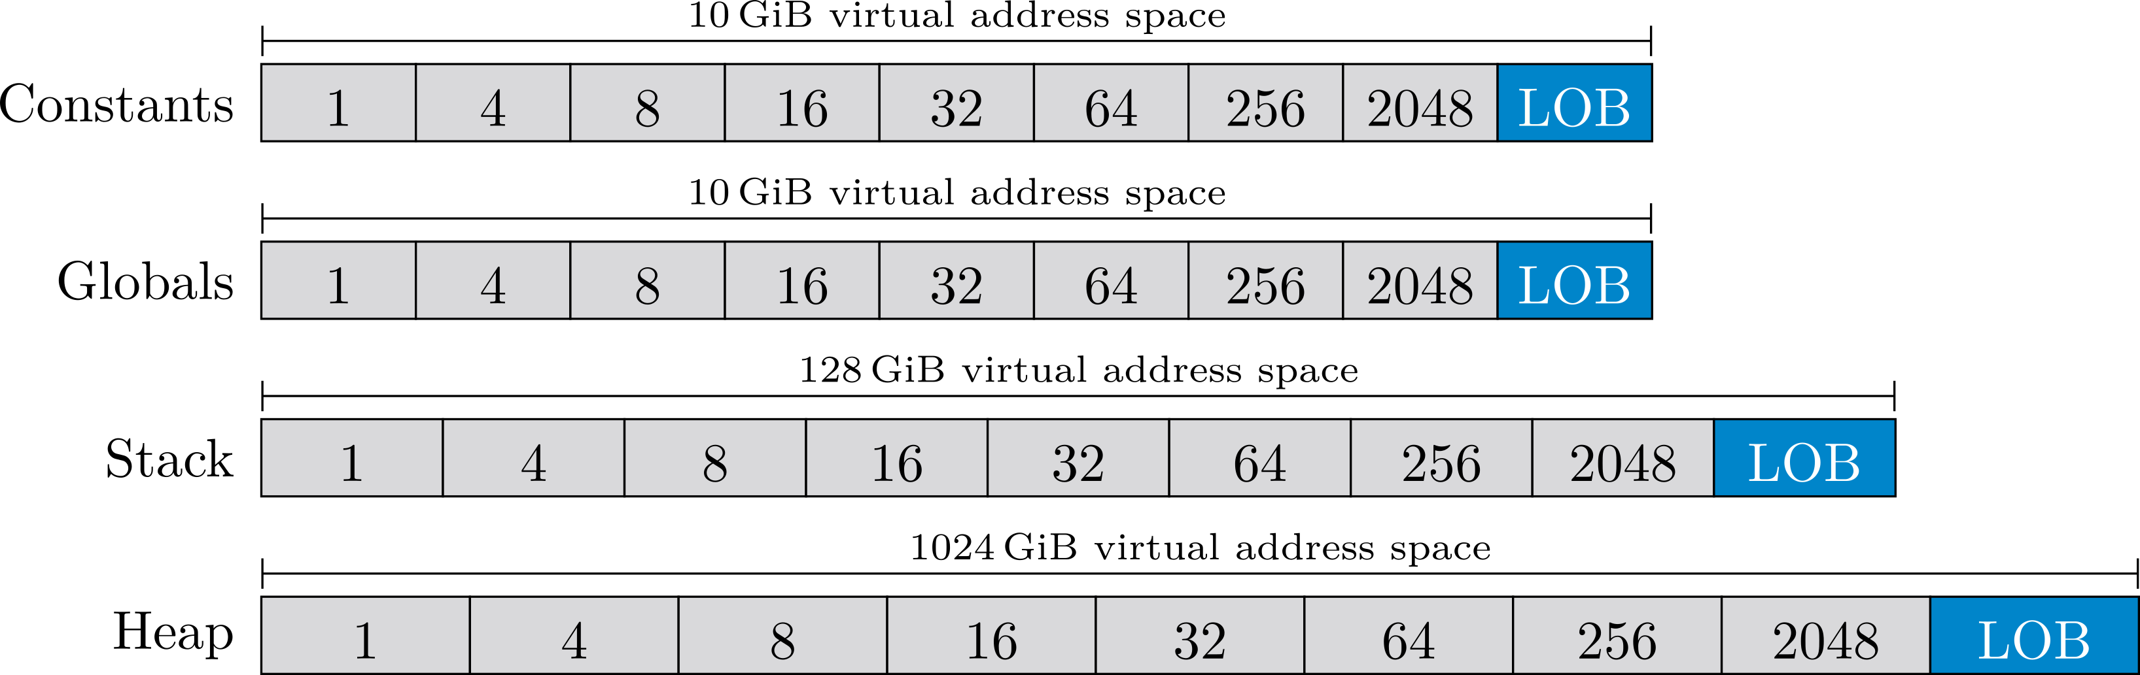
Memory Layout for KDAlloc

Slide 8
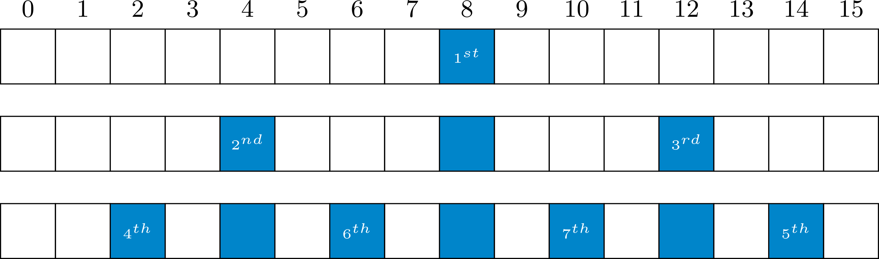
Slot Allocator for Sized Bins: Spatially Distanced

Slide 9
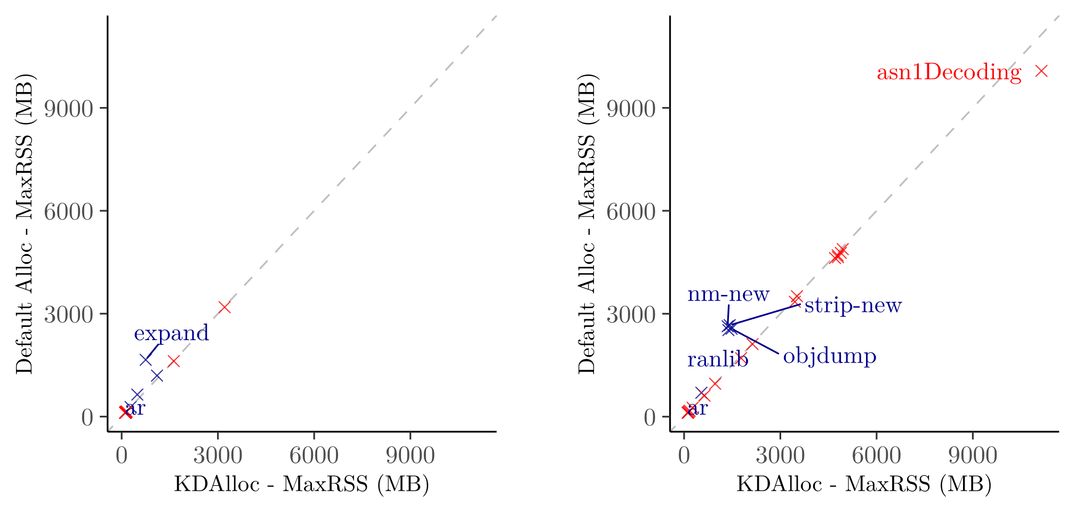
Memory Consumption
DFS
RndCov

Slide 10
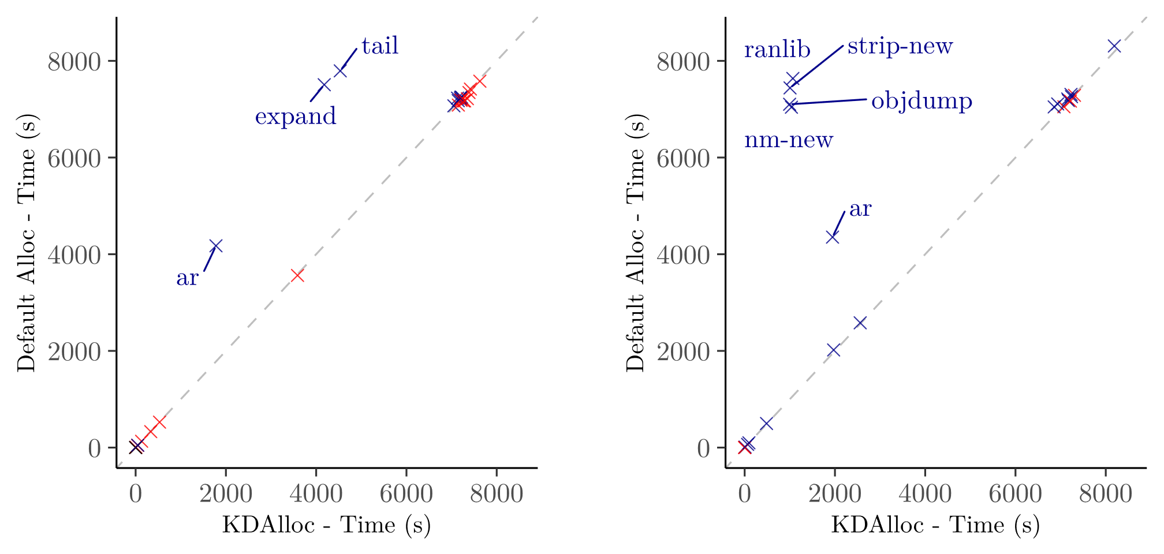
Performance
DFS
RndCov

Slide 11
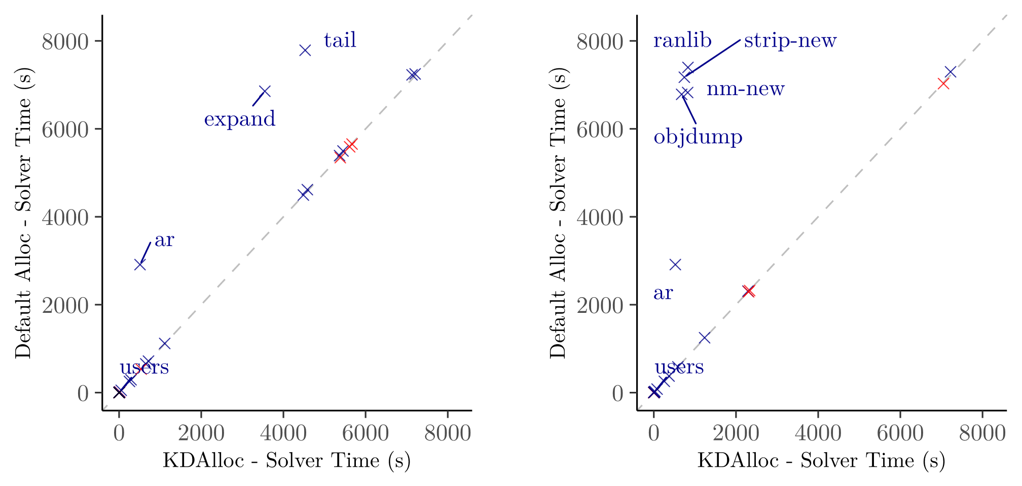
Solver Time
DFS
RndCov

Slide 12
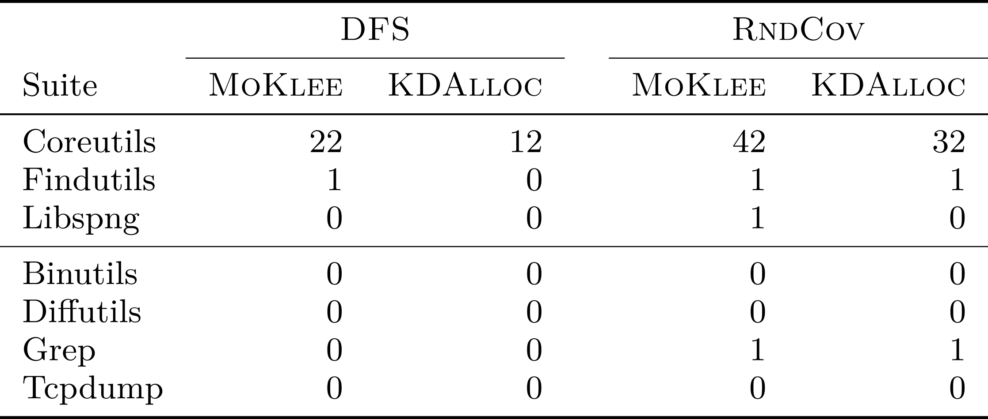
MoKlee: Fewer Diverging Locations

Slide 13
MoKlee: Fewer Divergences in memmove
char* s = (char*)dest;
const char* p = (const char*)src;
if (p >= s) {
while (n) {
*s++ = *p++;
--n;
}
} else {
while (n) {
--n;
s[n] = p[n];
}
}
return dest;
uClibc’s memmove is sensitive to memory layout

Slide 14
Summary & Conclusion
The memory allocator has significant impact on dynamic symbolic execution
We implemented KDAlloc in KLEE and show:
  Performance and memory consumption are not impacted negatively
  Use-after-free detection is improved (general benefit)
  Specific benefits for multiple DSE-based techniques
KDAlloc is becoming part of mainline KLEE!

Slide 15
Guaranteed Use-After-Free Behavior
char *mallocfree() {
char *s = strdup("A");
free(s);
char *t = strdup("B");
return s;
}
int main(void) {
char *s = mallocfree();
puts(s);
return 0;
}
KDAlloc guarantees detection when quarantine is enabled

Slide 16
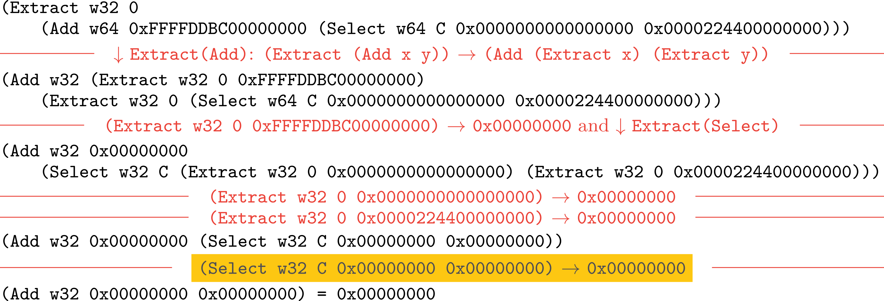
Query Structure with KDAlloc

Slide 17
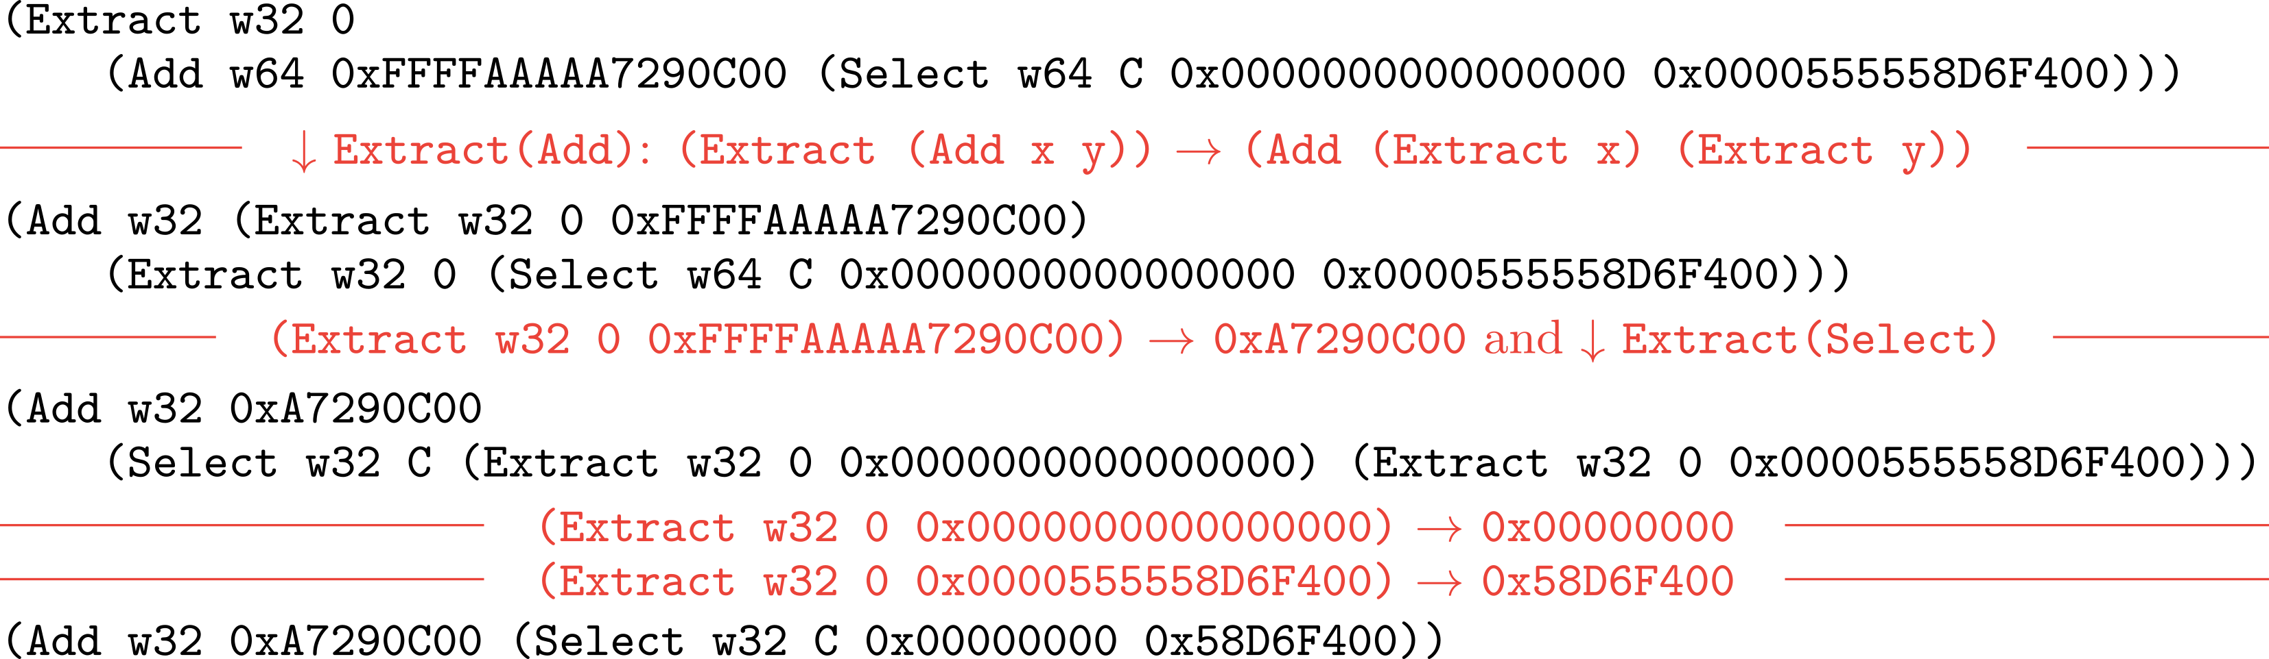
Query Structure without KDAlloc

